Slide 2
UNIT 3 TOEIC 250

Slide 3
UNIT 3: PERSONAL PRONOUNS
GRAMMAR:
LISTENING:
Unit 3: PRICES AND MONEY
UNIT 3: COMPUTER
VOCABULARY:

Slide 4

1. SUBJECT PRONOUNS
2. OBJECT PRONOUNS
3. POSSESSIVE ADJECTIVES
4. POSSESSIVE PRONOUNS
5. REFLEXIVE PRONOUNS
GRAMMAR:

Slide 5
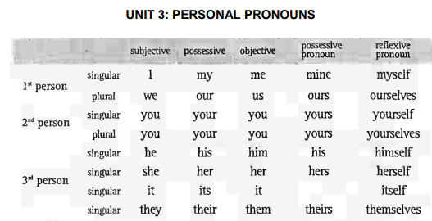

Slide 6
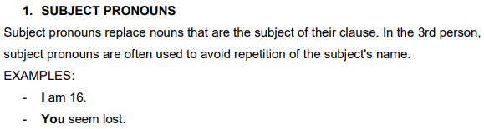
Subject pronouns

Slide 7
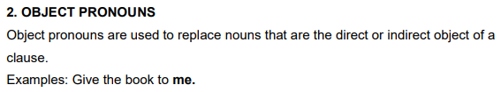
Object Pronouns

Slide 8
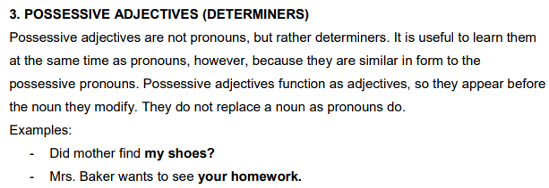
Possessive Adjectives
Possessive Adjectives

Slide 9
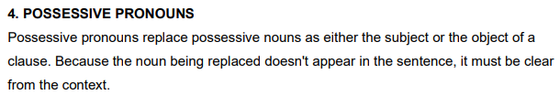
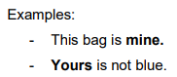
Possessive Pronouns

Slide 10
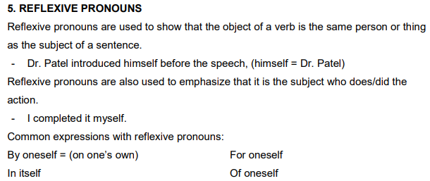
Reflexive Pronouns
Reflexive Pronouns

Slide 11
Grammar Practice

Slide 12
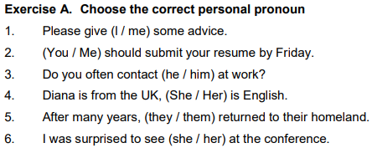
1. me 2. You
3. him 4. She
5. they 6. her

Slide 13
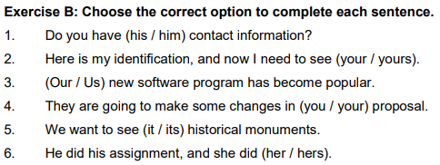
1. His 2. yours
3. Our 4. your
5. its 6. hers

Slide 14
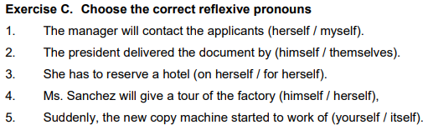
1. herself 2. himself
3. for herself 4. herself
5. Itself 6. themselves

Slide 15
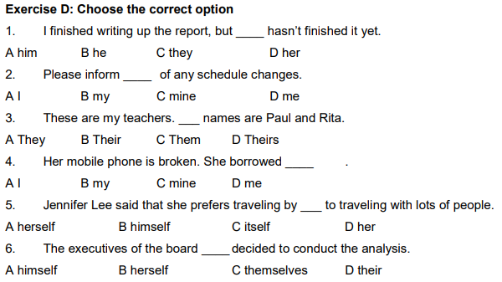
Exercise D
1. B 2. D
3. B 4. C
5. A 6. C

Slide 16
VOCABULARY
Marketing

Slide 17
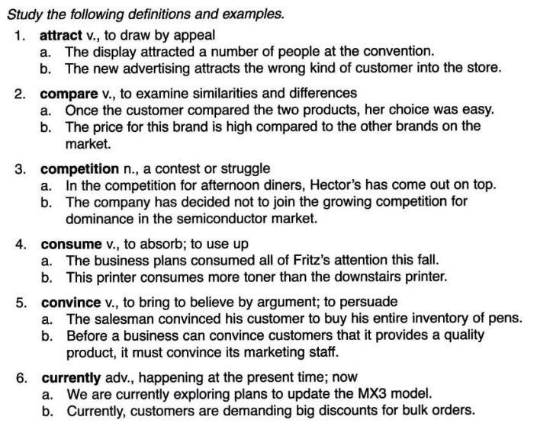
/əˈtrækt/
/kəmˈpeər/
/ˌkɒm.pəˈtɪʃ.ən/
/kənˈsjuːm/
/kənˈvɪns/
/ˈkʌr.ənt.li/

Slide 18
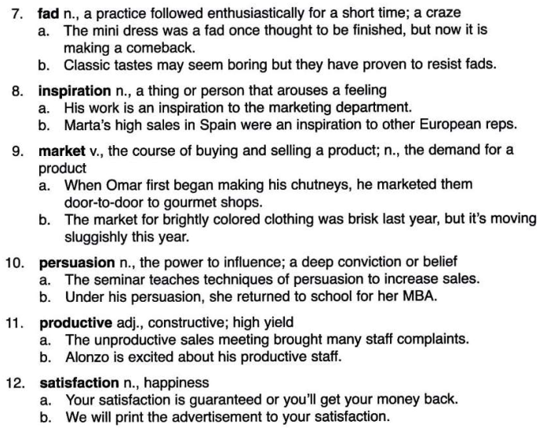
/fæd/
/ˌɪn.spɪˈreɪ.ʃən/
/ˈmɑː.kɪt/
/pəˈsweɪ.ʒən/
/prəˈdʌk.tɪv/
/ˌsæt.ɪsˈfæk.ʃən/

Slide 19
